Slide 1
Capstone Project 2: RNN Portfolio Analysis
Final Report by Joseph Javier

Slide 2
Motivation and Problem Statement
This project would implement a RNN that will model, observe, and forecast stock/exchange-traded funds (ETFs) data to determine the best stocks for portfolio growth. This would be relevant for investors, portfolio managers, financial/investment planners, and hedge/endowments to name a few. A few stocks will be selected for implementation and their collective performance will be observed.
My intended client would be any individual or institution concerned with investments. These entities would use my analysis and results for normal operations but also more importantly, for determining critical areas/weaknesses in a given timeframe should an unfortunate economic disaster occur such as the COVID-19 and Great Recessions. My project would serve as a reference and basis for implementing guidance, standard operating procedures, and investment education for the public.

Slide 3
Methodology and Approach
After downloading CSV data on some stocks of interest, I will clean, perform EDA, and split the data into a 70/30 training/test set.
Then, I predict the performance of buy-hold and buy signal strategies by implementing and training an RNN, more specifically a LSTM, over time.
This LSTM is later tested to predict how well a portfolio may perform over a specified timeframe.
The results are visualized through Matplotlib and Seaborn using time series plots and of course statistical EDA plots ensuring data/model validity.

Slide 4
Data Wrangling Steps
Obtained source daily data (as CSV files from the Yahoo finance website) for the following stocks/ETFs to observe investment potential: AAPL, AMZN, DIA, FB, MSFT, NFLX, SPY, TSLA, TWTR, and XOM.
Used “describe” and “info” DataFrame methods to determine data validity and integrity for all downloaded CSV files. If a null value were present, the SimpleImputer function that uses the mean of the previous and following data points would be used to impute it.
Created time series plots to observe price behavior over time.
Looked for outliers as “anomalies” or deviations from the general trend of the data. These were sought by plotting upper and lower yearly rolling bounds that are four standard deviations away from the yearly moving average. If a data point exceeds these bounds, then an outlier is found.

Slide 5
Data Storytelling
For this section, stock source data are analyzed to answer the following questions below. Numerous plots were generated and can be viewed in this GitHub repo link to the Jupyter Notebook containing the analysis.
How well are selected popular stocks and ETFs currently performing since their Initial Public Offering (IPO)?
Are there any correlations or covariances in pricing between the selected stocks and ETFs?

Slide 6
How well are selected popular stocks and ETFs currently performing since their Initial Public Offering (IPO)?
From plotting the source data, nearly all stocks/ETFs (i.e. TWTR being the exception) are performing well since their IPO. In other words, for a specified stock/ETF, if the final Adjusted Closing price is greater than the starting Adjusted Closing price, it should be considered as a potential investment opportunity. Some of them were unfortunately affected by market corrections such as the Great and COVID-19 Recessions (and even recovered over time), but the others continued to perform positively uninfluenced.

Slide 7
Are there any correlations or covariances in pricing between the selected stocks and ETFs?
Yes, most notably between any pairings of AAPL, AMZN, FB, MSFT, NFLX, DIA, and SPY. Any unique pairing will result in a high Pearson Adjusted Closing price correlation ranging anywhere from 0.87-0.99 and a high log covariance ranging anywhere from 7.1-13.0 as shown visually in the next section. Since all prices (i.e. High, Low, Open, Close, Adjusted Close), follow nearly identical shape and trend, we can safely assume that these correlations and covariances hold for all prices.

Slide 8
Statistical Data Analysis
For this analysis, Time Series EDA was performed and heatmaps of correlation and covariance were made.
These were performed on Adjusted Closing price data and, as alluded previously, we can safely assume that these results will be very similar for all prices since they follow nearly identical shape and trend.

Slide 9
Step 1: Conduct Time Series EDA
Create plots visualizing Density, Seasonality, Trend, and Noise for each stock/ETF to characterize the data as time series. Visualizations can be viewed in the corresponding Jupyter notebook.
Results and Findings:
Density: In the notebook, we see that five of them (AAPL, AMZN, MSFT, NFLX, and XOM) were priced closed to zero most of the time possibly due to the market not being familiar with them at first. The other five (TWTR, FB, TSLA, SPY, and DIA) already had popularity prior to their IPOs and caused price movement in the beginning. One minor caveat is for DIA, SPY, MSFT, and XOM, whose Close and Adjusted Close plots are different due to corporate actions and dividends.
Seasonality: By plotting the source data as done previously, we can suspect that there are no discernable patterns or cycles in any of the stocks/ETFs. These seasonality plots show straight horizontal lines at y = 0 which confirm this suspicion.
Trend and Noise: The source data was plotted alongside its yearly simple moving average to determine the general trend and focus less on the noise/fluctuations. We see that any of them either trend positive, negatively, or neither. Some even trend linearly or parabolically.

Slide 10
Step 2: Correlation and Covariance Analysis
Calculate Pearson correlation coefficients and covariances between stocks and ETFs (confirm if relationships are present between any stocks/ETFs).
Results and Findings: As stated in the Data Storytelling section, the Pearson Adjusted Closing price correlation coefficients and covariances of the all stocks/ETFs are shown in Figures 1 and 2 (next two slides), respectively.

Slide 11
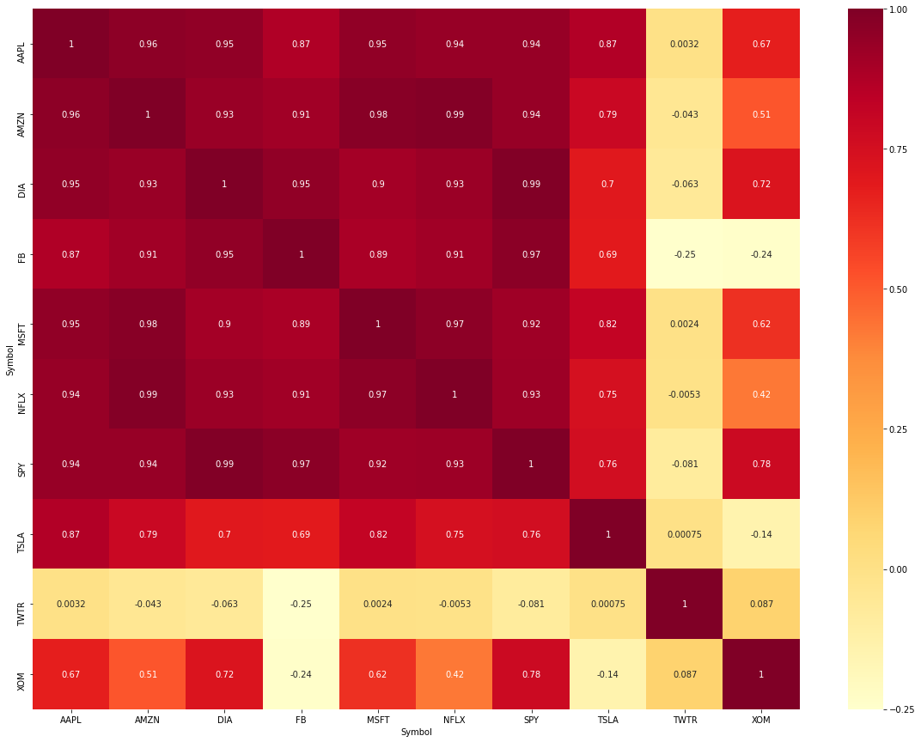
Figure 1. Correlation Coefficient Heatmap
Here in Figure 1, we see the strongest positive correlations shown by the dark red/maroon boxes meaning any pairing made from AAPL, AMZN, FB, MSFT, NFLX, DIA, and SPY. These make sense since:
These stocks are the top technology companies that have significant influence over the U.S. economy, and
These two ETFs are overall indicators of economic health and these technology companies are listed in these ETFs. Thus, for a simple buy-and-hold portfolio, investing in any or all of them should be considered.
On the other hand, we also see that correlations with TSLA, TWTR, and XOM range from moderately positive to essentially non-existent, but these stocks may be considered under different investing strategies.

Slide 12
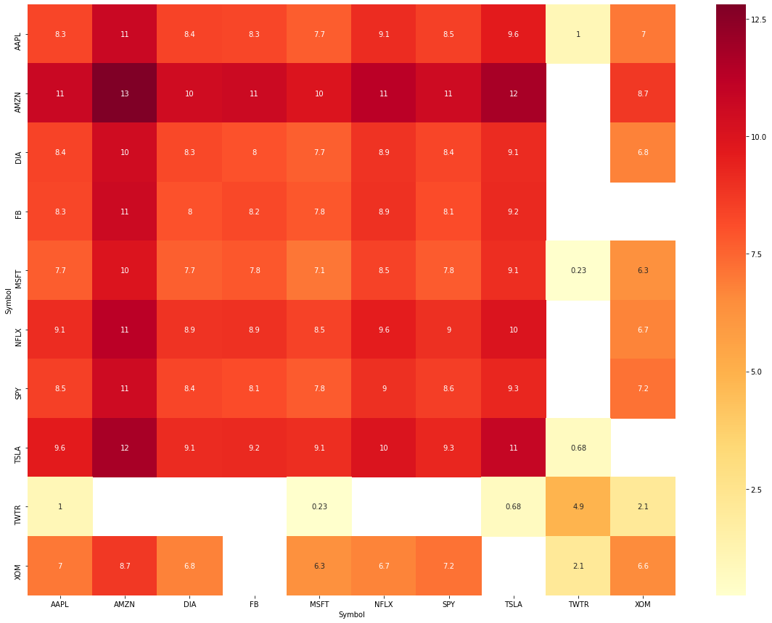
Figure 2. Covariance Heatmap
For Figure 2, the covariance data was logarithmically transformed for clarity since this properly highlights strong positive covariance and reinforces the strong relationships between pairings of the stocks/ETFs discussed previously. Using a linear scale would produce a misleading and confusing visualization.

Slide 13
In-Depth Analysis
This summarizes the steps used to assemble, test, and analyze the results of a simple RNN using the Keras library on a Graphics Processing Unit (GPU), namely a GTX 1070 Ti. An IPython notebook was created for each stock/ETF for a total of ten notebooks, but the following steps and analysis methodology remained consistent throughout. The code and RNN approach were obtained from a workshop presented at PyCon HK 2017 titled, “Recurrent Neural Networks in Python: Keras and TensorFlow for Time Series Analysis” and is instructed by Matt O'Connor. The Youtube link is provided below.
Workshop URL: https://www.youtube.com/watch?v=A7Lj_5AIkWQ

Slide 14
Step 1: Get and Clean Data
Read-in historical data as a DataFrame and drop any missing values due to faulty read-in. This is the same step as in Step 1 of the Data Wrangling section.

Slide 15
Step 2: Prepare Data
The historical data was pre-processed by adding the following columns to prepare for the next step:
Adjusted High/Low - High and Low prices adjusted to account for stock splits, dividends, and other stock trading events
Daily Return - the percent change in Closing Price of the current and previous trading days
Weekly Return - the percent change in Closing Price of the current and previous trading weeks (5 trading days ago)
Daily HL - Price range (Max - Min) for the 9:30am - 4pm trading day
Weekly HL - Price range (Max - Min) for the 5-day trading week
A “toTimeSeries()” function was defined to create trailing and leading columns based on a desired number of shifting periods. The resulting DataFrame will serve as observation data to be used by the RNN as training and testing data.

Slide 16
Step 3: Split into Training and Testing Data
The data was randomly split manually into a 75% training set and a 25% testing set. Then, these sets were reshaped to be used by the model.

Slide 17
Step 4: Assemble Model
This simple RNN model was compiled using the following layers:
Input Layer: an LSTM layer of 50 nodes feeding into the next layer
Hidden Layer 1: an LSTM layer of 50 nodes feeding into the next layer
Hidden Layer 2: an LSTM layer of 50 nodes feeding into the next layer
Output Layer: a Dense layer of 4 nodes (one node each for the Daily Return, Weekly Return, Daily HL, and Weekly HL columns)

Slide 18
Step 5: Train Model
The model was fit to the training set using the following parameters:
Batch size of 72 rows
50 epochs
Used the test set as validation data
Verbose = 2 (i.e. display loss and validation loss for each epoch)
No shuffling
Results and Findings: Plots all stocks/ETFs show the amount of Loss/Validation Loss over each epoch. Even though these show a difference, looking at this very small order of magnitude on the Y-axis means that this difference is essentially negligible. A sample plot for AAPL is shown in the next slide.

Slide 19
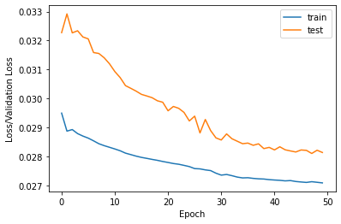
RNN Training on AAPL
The Y-axis is on the order of 10^-2 which is cents when factored into modelling thousands of dollars and is essentially negligible.

Slide 20
Step 6: Evaluate Model
After training, the model generated predictions on input test data (i.e. X_test). A "results" DataFrame was then created to store predictions and actuals (i.e. Y_test) for comparison. For each signal's prediction, a value was treated as an upward (positive) or downward (negative) vector. Accuracy scores were calculated as a number between 0-1 then defined based on two cases:
Direction and magnitude
Direction-only

Slide 21
Step 6: Evaluate Model (cont.)
Symbol | Direction and Magnitude Score (Closer to one is better) | Direction-Only Score (Closer to one is better)
AAPL | 0.1314 | 0.5577
AMZN | 0.0949 | 0.5404
DIA | 0.1574 | 0.5935
FB | 0.1018 | 0.5569
MSFT | 0.1097 | 0.5448
NFLX | 0.1026 | 0.5352
SPY | 0.1433 | 0.5797
TSLA | 0.0856 | 0.5596
TWTR | 0.0490 | 0.5220
XOM | 0.0456 | 0.5328
Results and Findings: Both scores for each stock/ETF are displayed in this table.
These results show a simple RNN model is not recommended and significant optimization and hyperparameter tuning is needed before it can be considered usable as shown in this table.

Slide 22
Step 7: Profit?
To see if this implementation is profitable, an annualized return was calculated over the entire investments (i.e. from IPO until now). A line plot was also generated for each stock/ETF to compare the performance against the well-known Buy and Hold strategy. These plots are shown at the end of every notebook.

Slide 23
Step 7: Profit? (cont.)
Results and Findings: Annualized returns for each stock/ETF are displayed in this table.
Some perform well while others perform not so well. Additionally, these values are not constant and may fluctuate at any time. Overall, this reinforces the point that a simple RNN model is not recommended as stated previously in Step 6.
Symbol | Annualized Return (Higher is Better)
AAPL | -1.4640%
AMZN | 3.2110%
DIA | -0.0654%
FB | 4.1346%
MSFT | -0.9918%
NFLX | -0.8805%
SPY | 2.5860%
TSLA | 4.5894%
TWTR | 1.9580%
XOM | 1.3175%

Slide 24
Overall Comparison
To simulate the overall portfolio performance of a Simple RNN vs. a Buy and Hold Strategy, $1000 cash was invested in each stock/ETF at the time of their respective IPOs (i.e. $10,000 total starting portfolio). The RNN-prediction strategy generated buy and sell signals over time, while the Buy and Hold strategy just bought the stock/ETF at the time of IPO then did nothing. Figure 3 in the next slide shows the simulated performance of both over time.

Slide 25
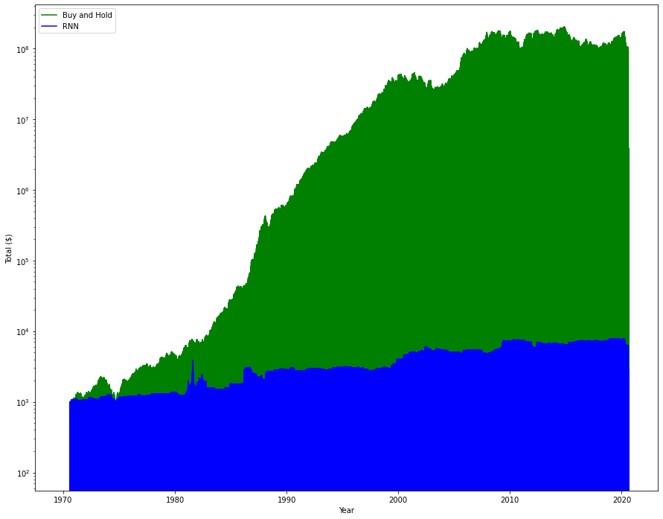
Figure 3. Performance Comparison
After factoring in profit/loss and transaction fees, the RNN-prediction strategy resulted in a current portfolio value of about $2,810, while the Buy and Hold strategy resulted in a current portfolio value of about $84,858. Thus, the Buy and Hold strategy vastly outperformed the RNN-prediction strategy.

Slide 26

Hope this project was informative!!

